Slide 1


FLUID TRANSPORTATION NETWORK
DONE BY GROUP 16
AKTOTY BEKETOVA
ASSANALI KAIDAROV
ASKHAT DOSCHANOV
AIMIRA RYCHSHANOVA
RUSTAM ALIMKULOV
RUSLAN MANNANOV
ABILMANSUR YESTAY
TEMIRLAN ZHOLAMAN

Slide 2
RESPONSIBILITIES
Report:
Aktoty Beketova
Assanali Kaidarov(associate leader)
3D modeling :
Askhat Doschanov
Aimira Rychshanova
Coding:
Rustam Alimkulov
Ruslan Mannanov
Presentation:
Abilmansur Yestay
Temirlan Zholaman(team leader)

Slide 3

AIMS OF THE PROJECT
Integrate and develop engineering skills of each team member during building a fluid transportation network
Learn CAD skills via working in Rhinoceros 3D
Learn Python , to further implement coding skills in our project

Slide 4
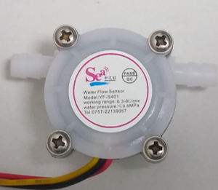
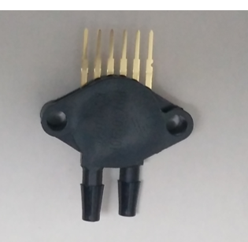
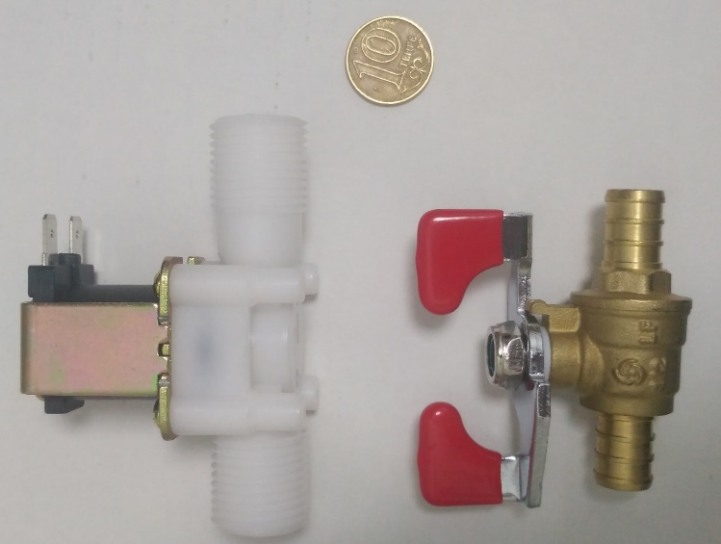
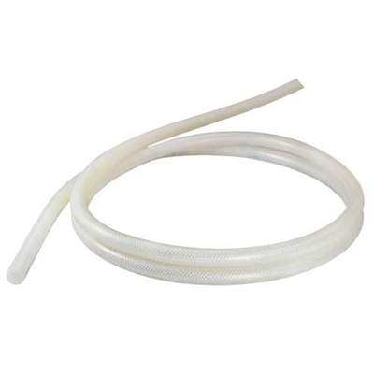
PROVIDED ITEMS
Flow rate sensor
Differential pressure
sensor
Solenoid valve
Silicon tubing

Slide 5
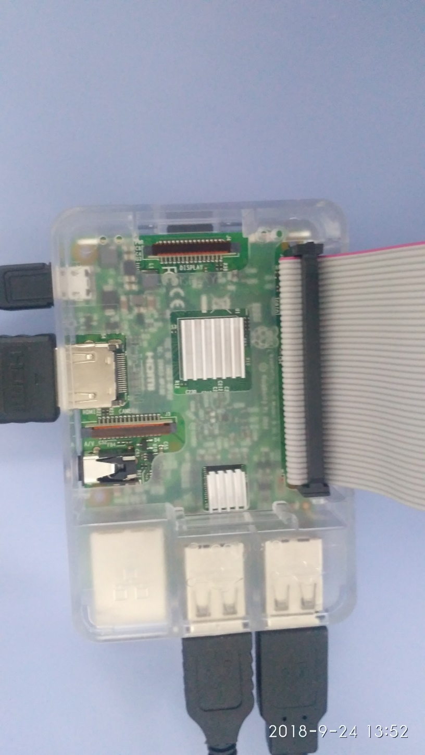
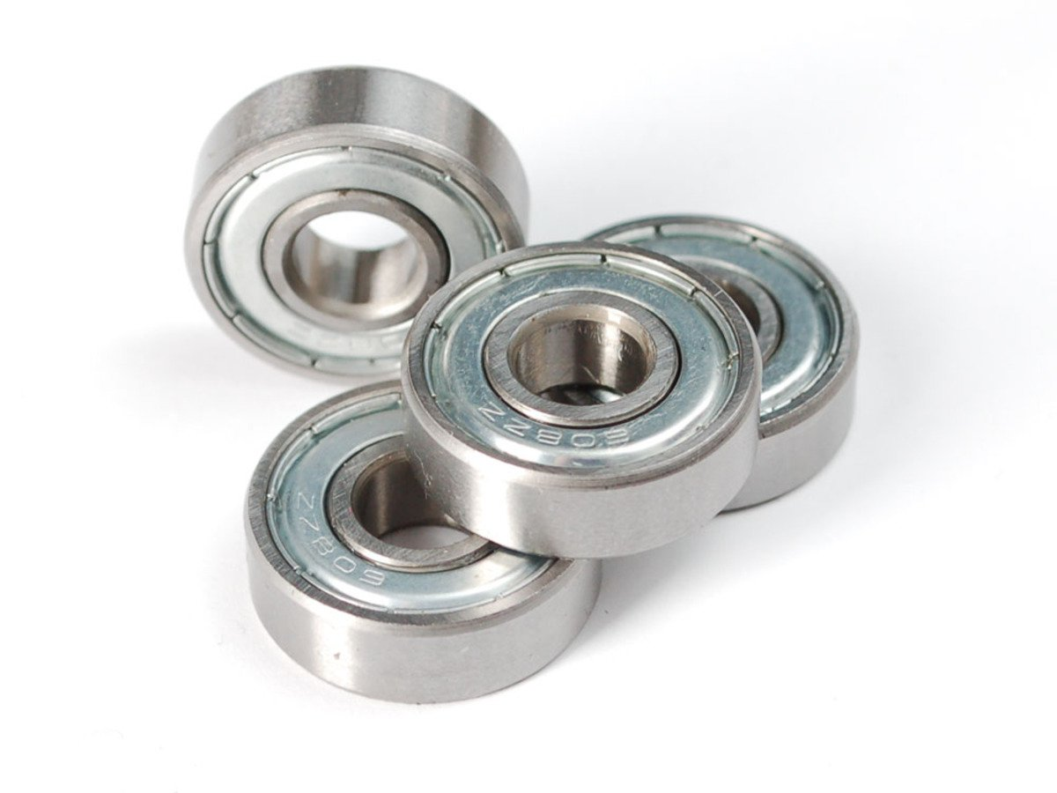
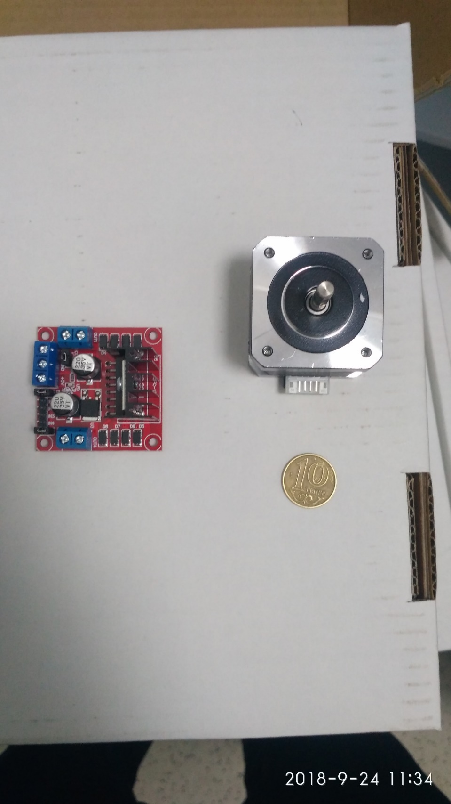
PROVIDED ITEMS
Stepper motor & motor controller
Ball bearings
Raspberry Pi microcontroller
And other items

Slide 6
PUMP DESIGN AND DESIGN CHOICE
During the design selection, our group considered following aspects:
Providing flow rate of 0.5 to 1L/min
Reasonable waste of PLA material
Consistency of printed components with the motor setup for moving and secure connection of them

Slide 7
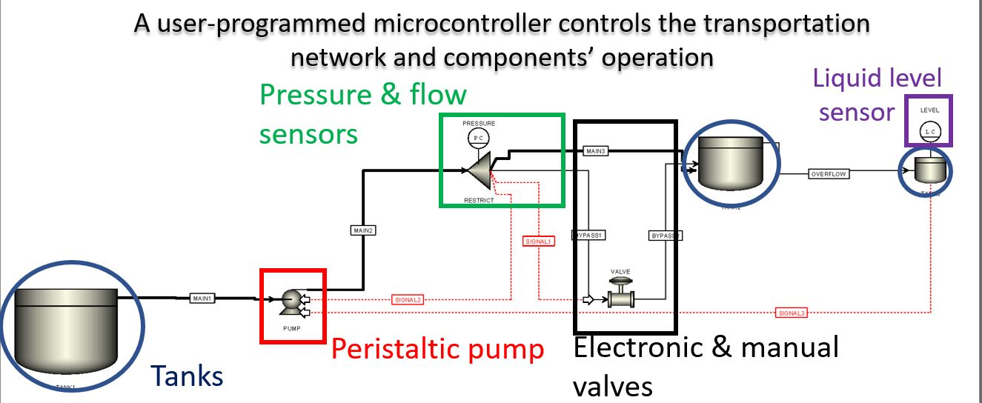
SCHEME OF FLUID TRANSPORTATION NETWORK

Slide 8
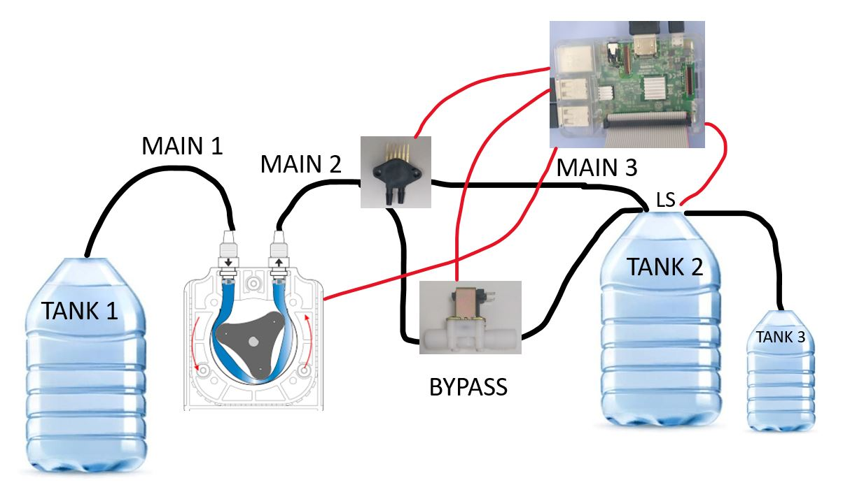
FLUID TRANSPORTATION NETWORK

Slide 9
CRITERIAS FOR THE FLUID TRANSPORTATION SYSTEM
Transfer fluids( in our case water) from Tank1 to Tank2 with a flow rate from 0.5 to 1 L/min.
In case of excess of flow, Tank2 should have an overflow mechanism directing it to Tank 3
Identify flow rate at ‘Main 2’ pipe.
Identify pressure (or pressure difference) at ‘Main 2’ pipe.
Identify the liquid level at Tank 3
During normal operation the electronic valve shown in Figure 1 should be closed. If blockage occurs (or is introduced) in ‘Main 2’ pipe, the controller should automatically open the electronic valve and direct flow to Tank 2 via ‘Bypass 1 & Bypass 2’ pipes.
If liquid level at Tank 3 rises above a certain level the controller should stop the pump and restart pumping operation only when liquid level drops to acceptable levels.

Slide 10
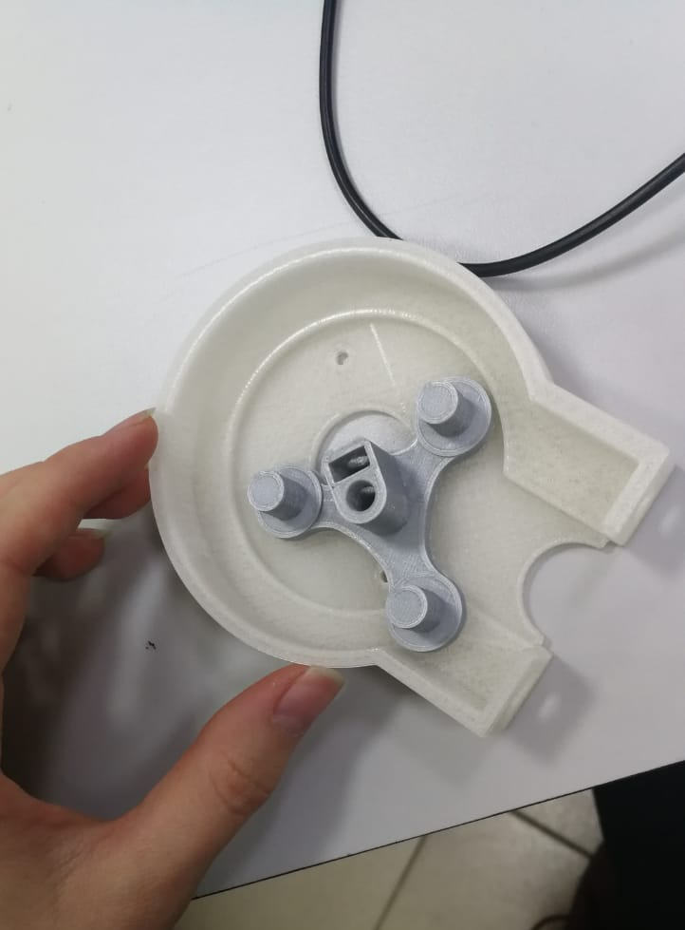
PRINTING KEY ELEMENTS
Considering the rotor, we minimized the overall size as possible (28.5 mm). The smaller the radius of the rotating object, the smaller the momentum that facilitates the work of the motor
Case: the overall radius of the casing is 39 mm, with 4 holes in it, with radius 1.575 mm each.
Printed rotor and casing

Slide 11
MATERIALS AND PRINTING
For printing we were given ABS filament and PLA. We decided to use PLA.
To test design, we have conducted the preparation in CURA application.

Slide 12
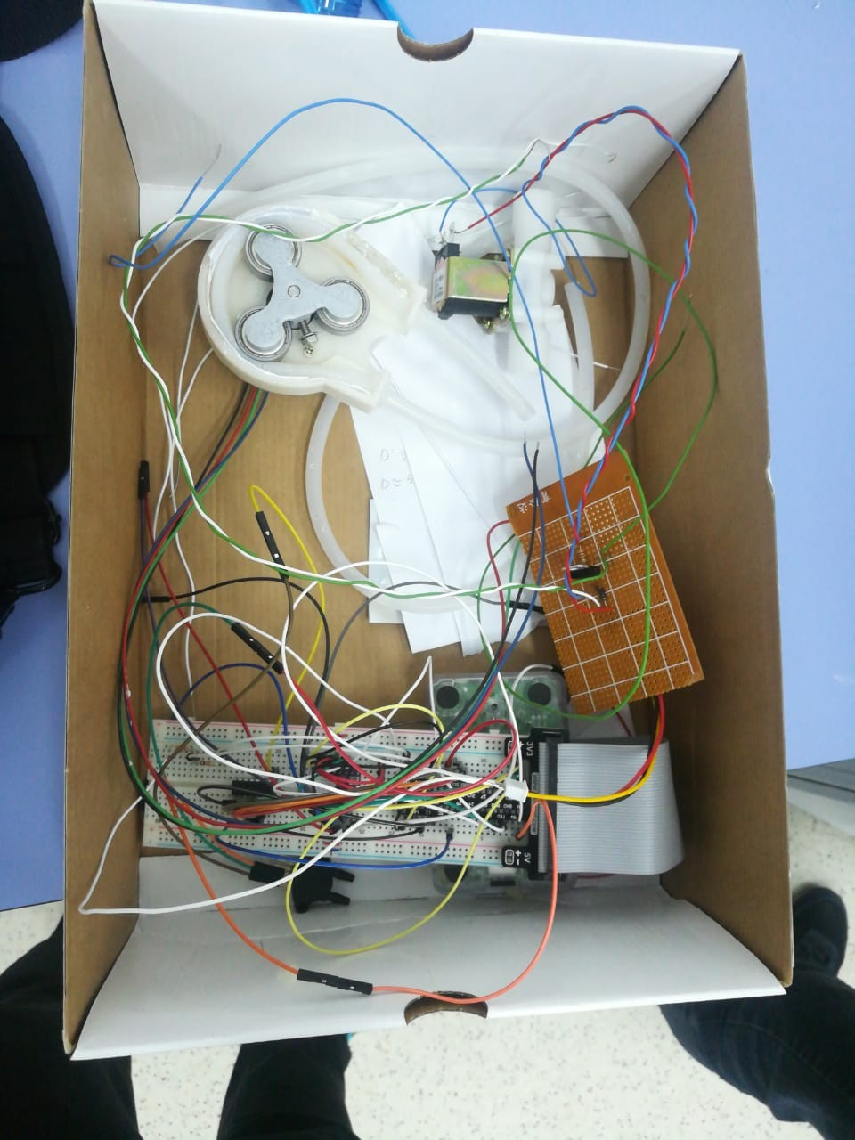
BEFORE THE ASSEMBLY

Slide 13
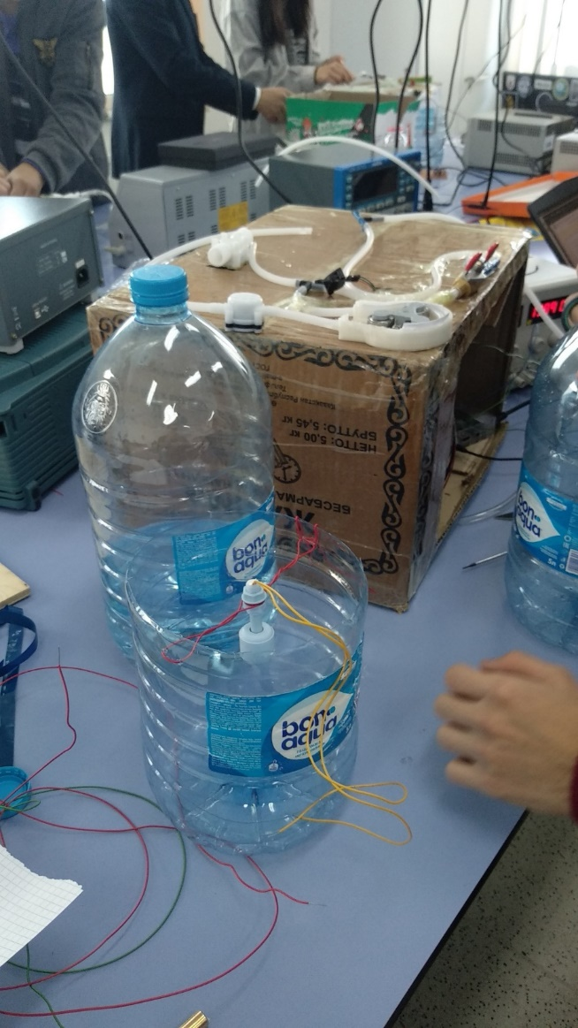
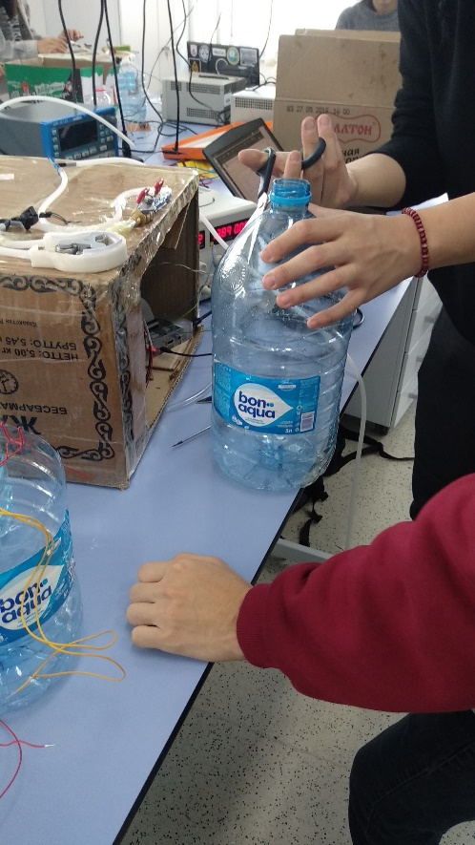
PREPARATION
Preparation of tanks
Tank 2

Slide 14
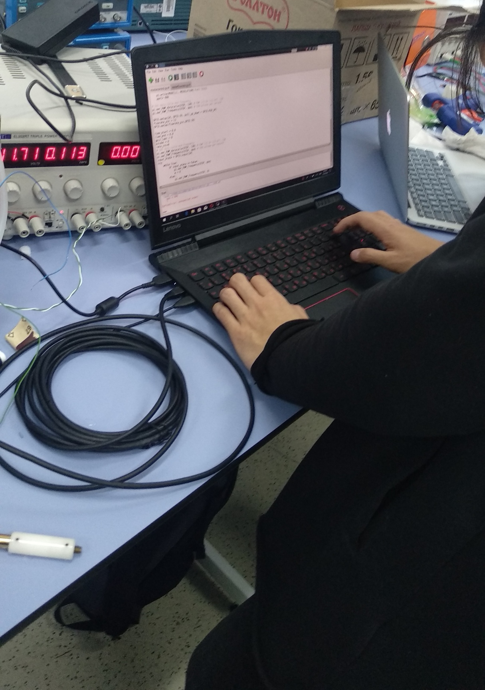
CODE
We have written code that can
Start and stop the pump.
Observe values from the system sensors , like level, pressure and flow sensors.
Opening and closing the electronic valve

Slide 15
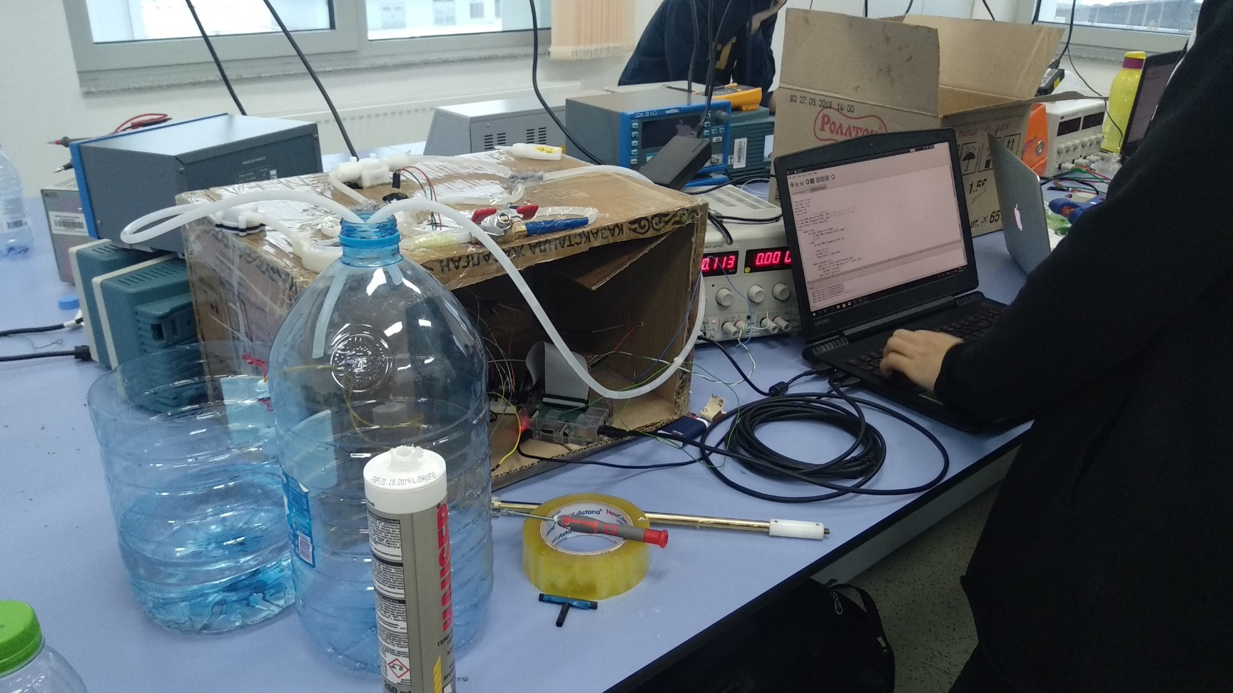
WORKING FLUID TRANSPORTATION SYSTEM

Slide 16
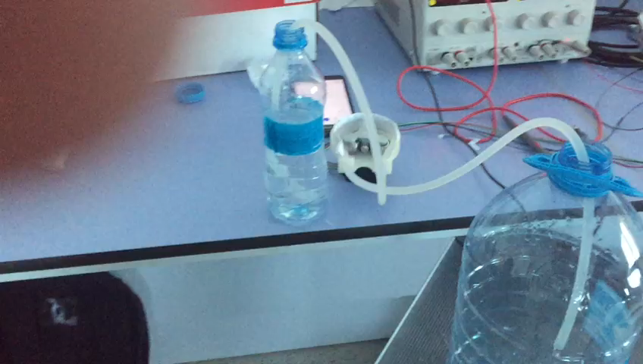
VIDEO
All videos will be included in the additional folder.

Slide 17
RESULTS FROM EXPERIMENT
Transfer of 0.5 L liquid from Tank 1 to Tank 2 took 57.15 seconds.
Transfer of 1.128 L water from Tank 1 to Tank 2 took exactly 2 minutes . The flow rate was approximately 0.5L per minute. Respectively, after 2.5 minutes we stopped the flow. In the result 1.46L of water was in Tank 2 overall.
0.8L/min rate was not up to our system, as it cannot sustain, maintain this pressure in the tubes. So, we completed an alternative version of the task. The flow of water of 0.515L/min rate was launched steadily for 3 minutes.

Slide 18
ERROR AND PROBLEMS WE FACED
During coding and assembling the project our team faced following problems
Water leak:
Problems with water leak led to problems with pressure sensor which led caused inability to operate electronic valve.
Time
Small design error

Slide 19
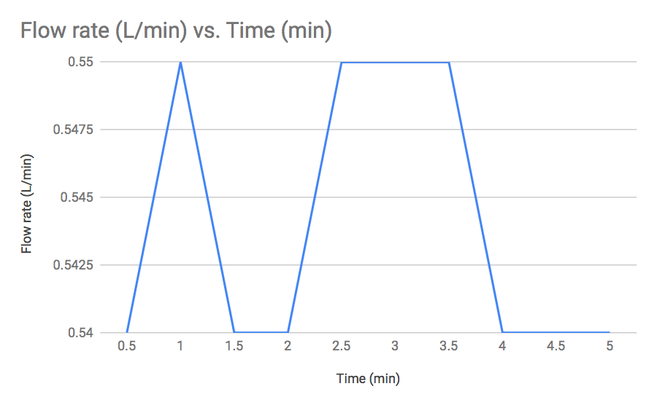
GRAPHS
Flow vs time graph
For period of 5 mins

Slide 20
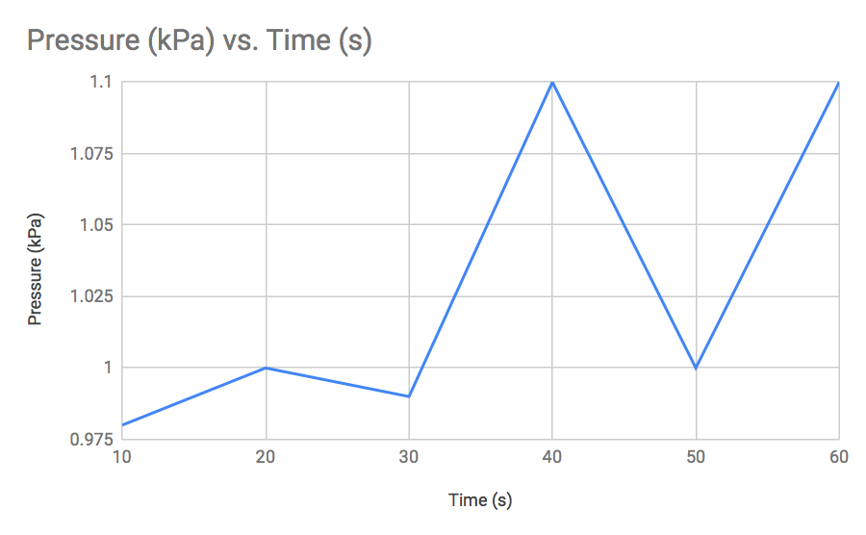
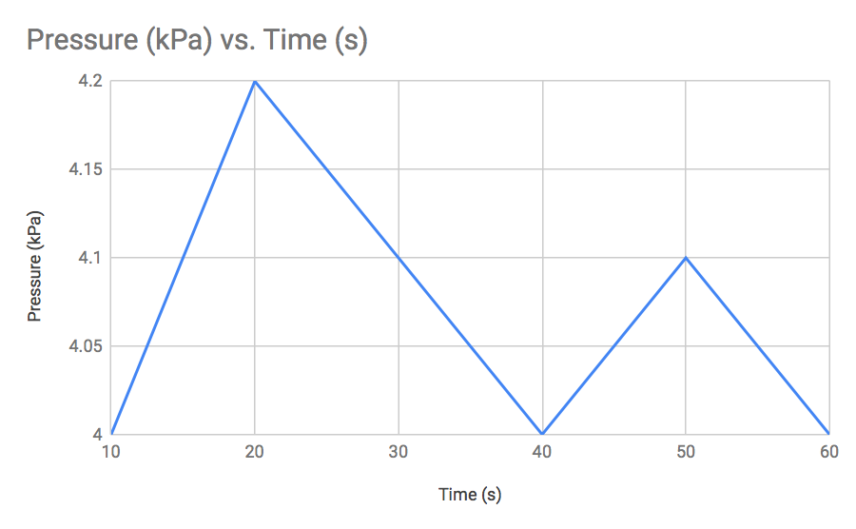
GRAPHS
Pressure(kPa) vs Time for open main2 Pressure(kPa)vs Time for closed main2

Slide 21
VISCOSITY
All measurements will be included in report.

Slide 22
Thank you for attention

Slide 23
REFERENCE
1. Pictures were taken from project presentation.

